Slide 1
Innov8 2.0 Project satya
Omkar Bhandare
​​Rishit Garg
Parth Patil
Nived Shah

Slide 2

About the project
Satya's primary mission is to assist HR professionals in navigating the complex world of resumes, recommendation letters, and professional networks. By leveraging advanced AI techniques, Satya aims to uncover hidden patterns, verify credentials, and provide insightful analysis beyond surface-level information.

Slide 3
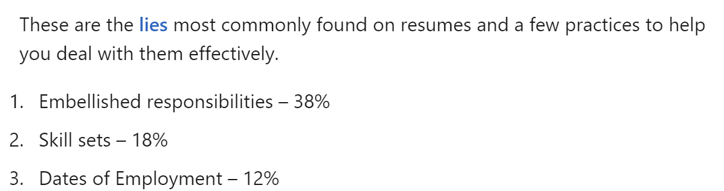
Fraud detection
Vague Phrases
Authenticity of LoRs
Identifying phrases that overstate qualifications or show lack of experience
Checking specificity of recommendation and flagging use of embellished statements
Reciprocal Endorsements
Timeline Inconsistencies
Looking for recursive endorsements
Millennials account for about a quarter of the $48 billion spent on other products in 2018​
LinkedIn

Slide 4




Solution
WHY SATYA
WHAT IT DOES
FOR WHOM
IMPACTS
Organizations face significant risks from fraudulent claims, which can lead to poor hiring decisions and impact overall team performance.
Employ robust algorithms to scrutinize Resumes and identify fraud indicators. Provide an easy-to-use interface for screening and ranking candidates.
A large-scale platform targeting efficiency and authenticity in the hiring process via HRs and providing candidates with a fair opportunity to get ranked in their job applications.
Reduce risk of frauds, enhance hiring quality, improve team dynamcis, reduce valuable time-consuming process of manual screening.

Slide 5
WHY SATYA
Organizations face significant risks from fraudulent claims, which can lead to poor hiring decisions and impact overall team performance.

Slide 6
WHAT IT DOES
Employ robust algorithms to scrutinize Resumes and identify fraud indicators. Provide an easy-to-use interface for screening and ranking candidates.

Slide 7
FOR WHOM
A large-scale platform targeting efficiency and authenticity in the hiring process via HRs and providing candidates with a fair opportunity to get ranked in their job applications.

Slide 8
IMPACT
Reduce risk of frauds, enhance hiring quality, improve team dynamcis, reduce valuable time-consuming process of manual screening.

Slide 9
HR DASHBOARD - INSIGHTS
An interactive dashboard for HRs to
View Resume Scores of candidates at a glance
Compare candidates with each other
Define Job Application domains​

Slide 10
Company Overview

Slide 11



Business Model
Research​
Abstract​
Design​
We based our research on market trends and social media​
We believe people need more products specifically dedicated to this niche market​
Minimalist and easy to use ​

Slide 12
Market opportunity overview
$3b
$1b
$2b
Opportunity to build​
Fully inclusive market​
Total addressable market​
Freedom to invent​
Selectively inclusive market​
Serviceable available market​
Few competitors​
Specifically targeted market​
Serviceable obtainable market​

Slide 13
Market opportunity comparison
$3B
Opportunity to Build
Revenue over 12 months​
$2B
Freedom to Invent
Market share​
$1B
Few Competitors
Obtainable market​

Slide 14
Our competition
CoNTOSO
competitors
Our product is priced below that of other companies on the market​
Design is simple and easy to use, compared to the complex designs of the competitors​
Affordability is the main draw for our consumers to our product​
Company A​ Product is more expensive​
Companies B & C ​ Product is expensive and inconvenient to use​
Companies D & E​ Product is affordable, but inconvenient to use

Slide 15
Our competition graphic
convenient
Contoso
A
expensive
affordable
D
B
C
E
Inconvenient​

Slide 16
Growth strategy
How we’ll scale in the future
Feb 20xx
May 20xx
Oct 20xx
Roll out product to high profile or top-level participants to help establish the product​
Release the product to the general public and monitor press release and social media accounts​
Gather feedback and adjust product design as necessary​

Slide 17
Traction
Forecasting for success​
Key metrics
Revenue by year
 | clients | orders | Gross avenue | Net revenue
20XX​ | 10​ | 1100​ | $10,000​ | $7,000​
20XX​ | 20​ | 200​ | $20,000​ | $16,000​
20XX​ | 30​ | 300​ | $30,000​ | $25,000​
20XX​ | 40​ | 400​ | $40,000​ | $30,000​
20XX​ | 50​ | 500​ | $50,000​ | $40,000​
20XX | 10 | 1100 | $10,000 | $7,000

Slide 18
Two-year action plan
Draft blueprints​
Run focus groups​
Gather feedback​
20XX
Jan
Feb
Mar
Apr
May
Jun
Jul
Aug
Sep
Oct
Nov
Dec
Test design​
Launch design​
Deliver to client
20XX
Jan
Feb
Mar
Apr
May
Jun
Jul
Aug
Sep
Oct
Nov
Dec

Slide 19
financials
 | Year 1 | Year 2 | year 3
Detailers​ | 5,000​ | 40,000​ | 160,000​ | ​
Users​ | 50,000​ | 400,000​ | 1,600,000​ | ​
Sales​ | 500,000​ | 4,000,000​ | 16,000,000​ | ​
Average price per sale​ | 75​ | 80​ | 90​ | ​
Revenue @ 15%​ | 5,625,000​ | 48,000,000​ | 216,000,000​ | ​
Gross Profit​ | 5,625,000​ | 48,000,000​ | 216,000,000​ | ​
Expenses​ | ​ | ​ | ​ | ​
Sales & marketing​ | 5,062,500​ | 38,400,000​ | 151,200,000​ | ​
Customer service​ | 1,687,500​ | 9,600,000​ | 21,600,000​ | 70%​
Product development​ | 562,500​ | 2,400,000​ | 10,800,000​ | 10%​
Research​ | 281,250​ | 2,400,000​ | 4,320,000​ | 5%​
Total Expenses​ | 7,593,750​ | 52,800,000​ | 187,920,000​ | 2%​
EBIT | -1,968,750 | -4,800,000 | 28,080,000 | ​

Slide 20
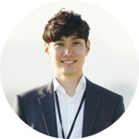



Our team
Takuma Hayashi​​
Mirjam Nilsson​​
Flora Berggren​​
Rajesh Santoshi​​
President
Chief Executive Officer​
Chief Operations Officer​
VP Marketing​

Slide 21








Our team
Takuma Hayashi​​
Mirjam Nilsson​​
Flora Berggren​​
Rajesh Santoshi​​
President
Chief Executive Officer​
Chief Operations Officer​
VP Marketing​
Graham Barnes​
Rowan Murphy​
Elizabeth Moore​
Robin Kline​
VP Product​
SEO Strategist​
Product Designer​
Content Developer​

Slide 22
Funding
12K
14K
32K
82K
Property
Angel Investments
Cash
Shares
Revenue obtained from property rentals​
Amount obtained through other investors​
Liquid cash we have on hand​
Number of shares converted into USD​

Slide 23
Summary
At Contoso, we believe in giving 110%. By using our next-generation data architecture, we help organizations virtually manage agile workflows. We thrive because of our market knowledge and great team behind our product. As our CEO says, "Efficiencies will come from proactively transforming how we do business."​

Slide 24
Thank you
Mirjam Nilsson​​
206-555-0146​
mirjam@contoso.com​
www.contoso.com​

